Slide 1
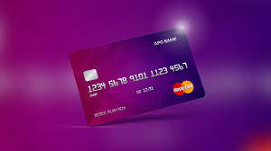

Credit Card Behavior

Slide 2

Problem
Divide the customers into groups to direct the suitable marketing.

Slide 3
Simple Description of data
18 Features
8950 Customers
missing values min-payments feature (0.034), credit-Limit (0.0001)
Most skewed to right
A lot of outlier
27% are zero values
17 Features are num
1 is object
No Negative values,
No duplicated Row
Different scaling data

Slide 4
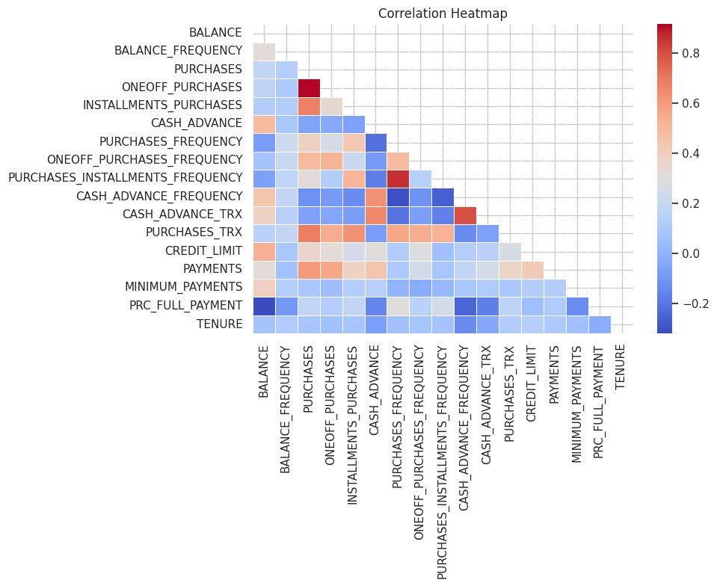
Most of relationship are moderate and strong, more dark blue or Maroon is more relationship.

Slide 5
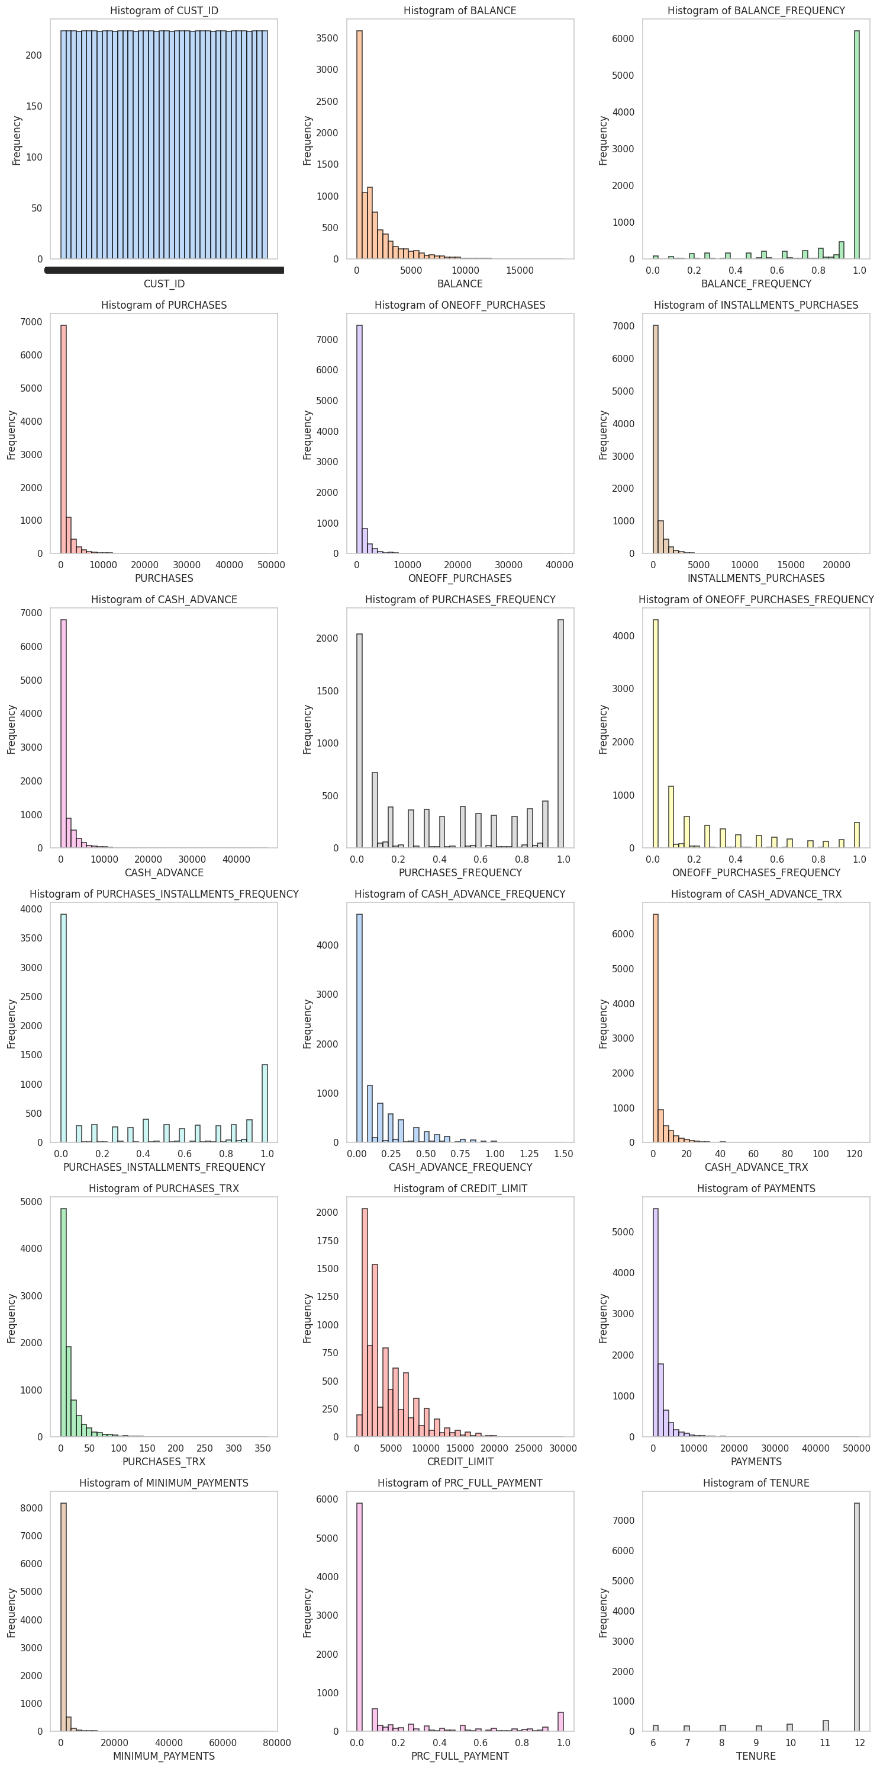
>> Most of distribution are skewed to right . >> existence outlier. >> Number of zeros is high.

Slide 6
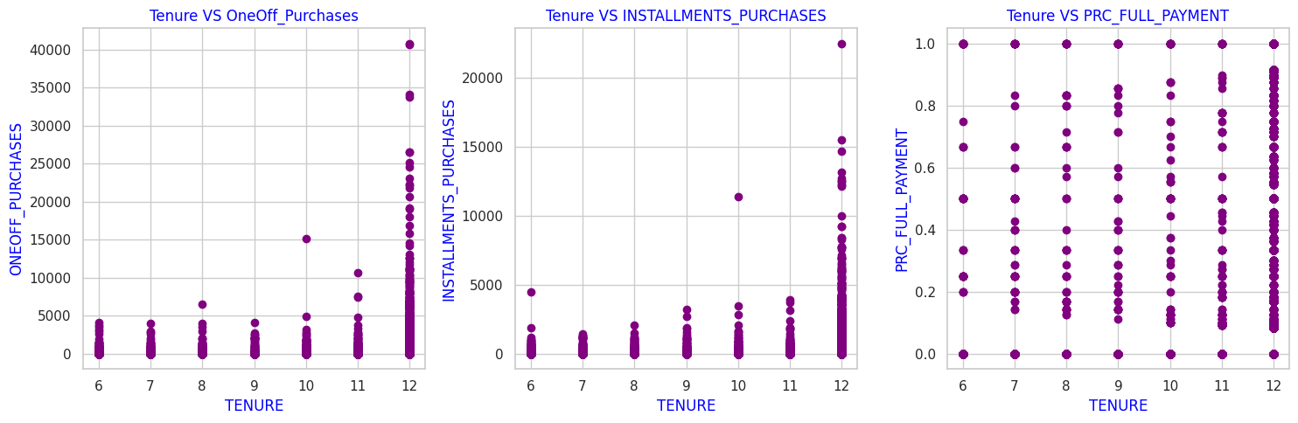
>> Most customers prefer long time for credit card >> increase utilization.
>> they can purchases expensive items or we can say they make a lot of purchases.

Slide 7
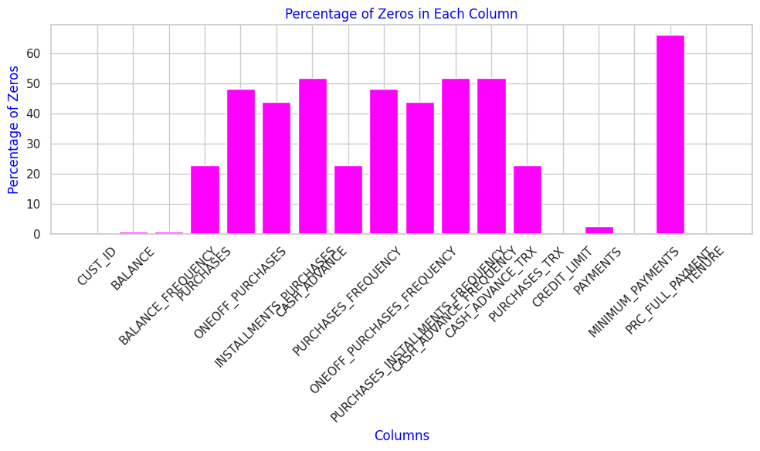
A lot of Zeros values.

Slide 8
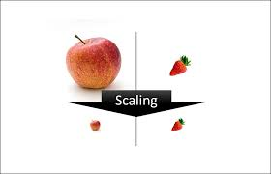
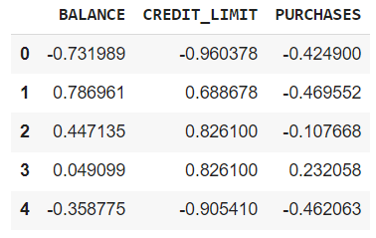
K-mean Algorithm is distance based, so it is sensitive to different scaling .
Using standard-Scaler is less sensitive to outlier.

Slide 9
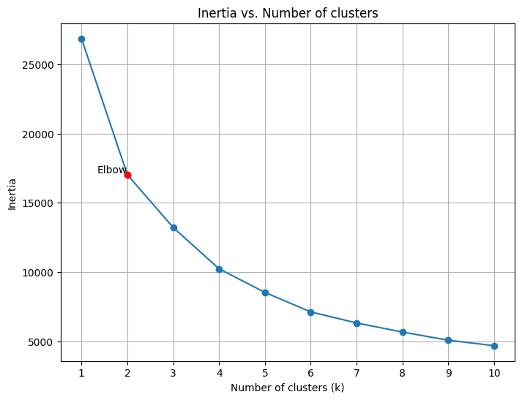
The best value based on is elbow at k = 2

Slide 10
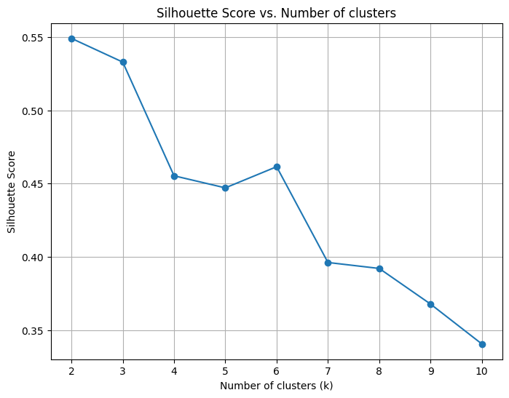
>> best value of k is 2
>> more precise than the previous , but computational expensive.
>> It is an indicator whether the similar instances are close and far about the dissimilar ones.

Slide 11
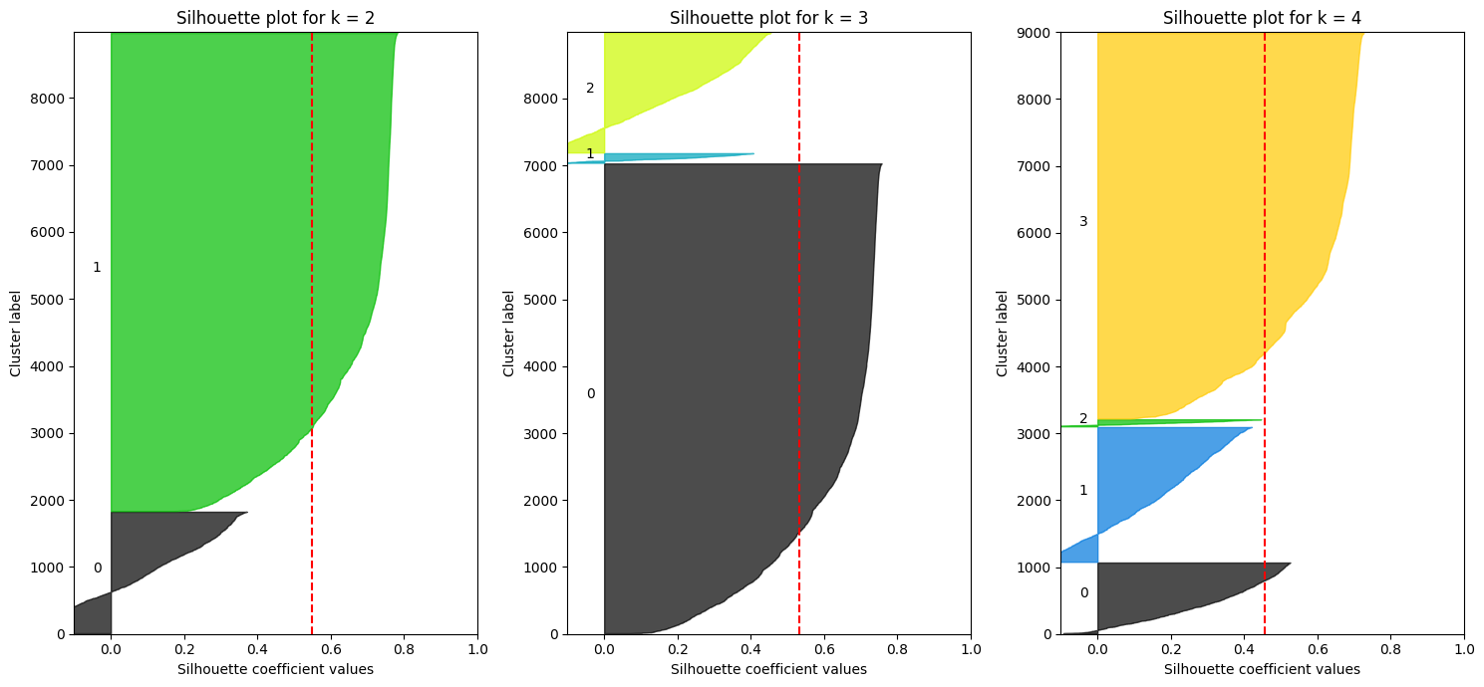
We have vertical dashed line represent sillhoutte score mean, closer edges of cluster better clusters. As we notice at k = 4 is the best. Sizes of clusters are different.

Slide 12
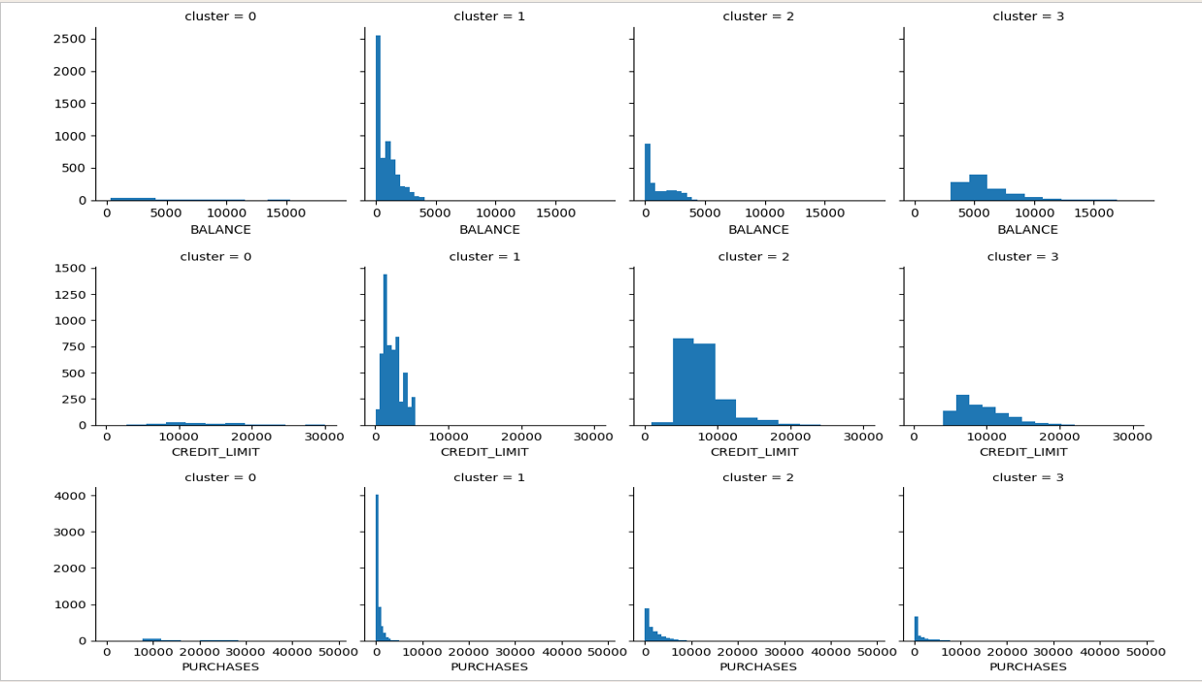
0: 'who make expensive purchases’, 1: "who make few and cheap purchases, low balance", 2: 'who has high credit limit’, 3: 'who has middle balance and low purchases ',

Slide 13
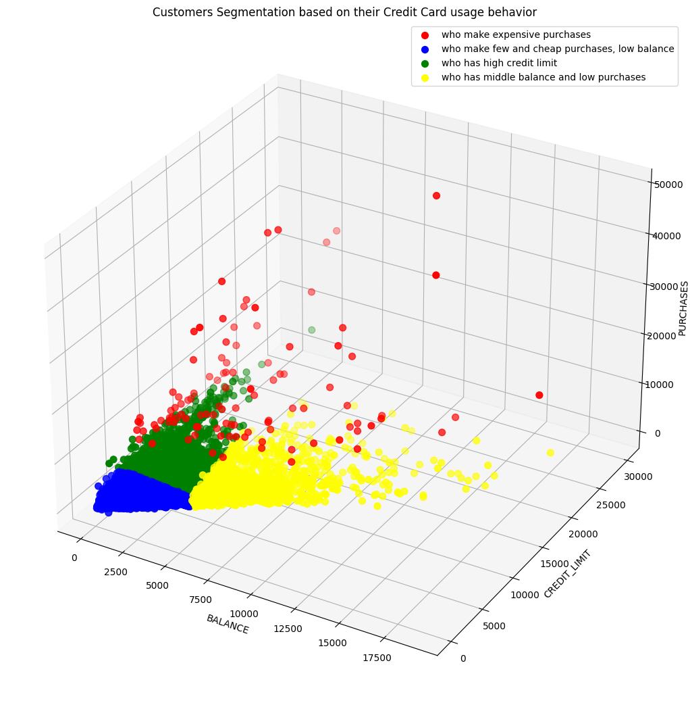
Final Chart for Clusters

Slide 14


